Slide 1
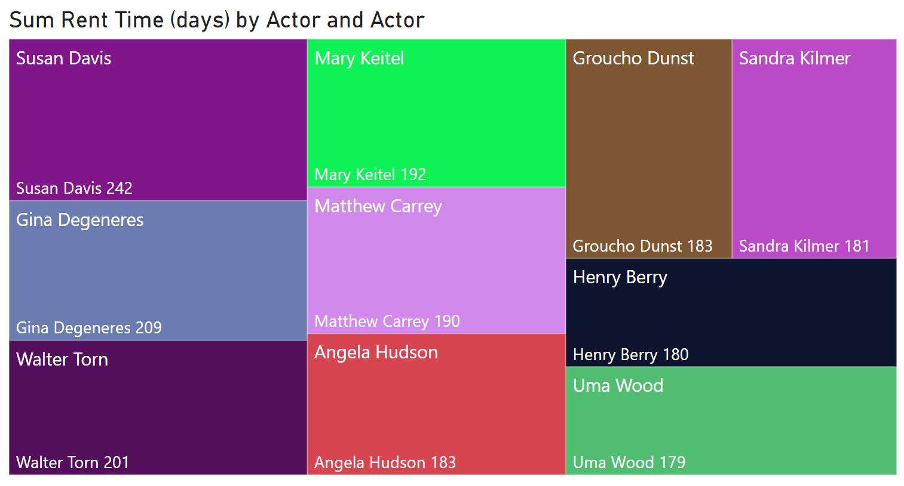
Actors with Most Rental Time
<visualization>
Here we can see the top 10 actors by total days in which their movies were rented. These actors may be more popular and could use more stock to assure their availability in each store.
Notes:
/* Which actors have the longest sum of rental time durations */
SELECT
concat(a.first_name, ' ', a.last_name) name,
sum(f.rental_duration) ttl_rent_time
FROM actor AS a
LEFT JOIN film_actor AS fm
ON fm.actor_id = a.actor_id
LEFT JOIN film as f
ON f.film_id = fm.film_id
GROUP BY a.actor_id
ORDER BY ttl_rent_time DESC;

Slide 2
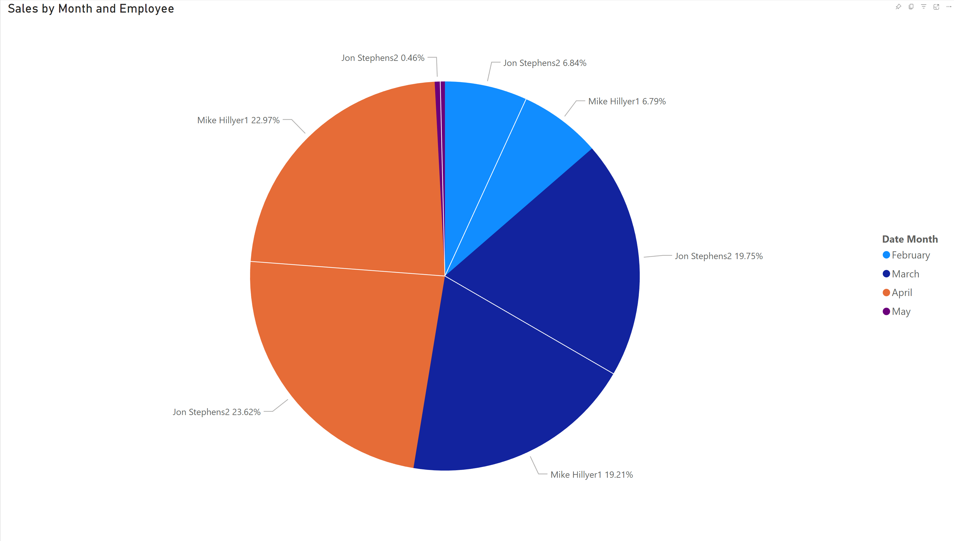
Employee Monthly Sales Performance (FEB-MAY)
<visualization>
Total Sales was higher for Jon Stephens2 (31,059.92) than Mike Hillyer1 (30,252.12).﻿
﻿Average Sales was higher for Jon Stephens2 (7,764.98) than Mike Hillyer1 (7,563.03).
﻿Sales for Jon Stephens2 and Mike Hillyer1 diverged the most when the Month was April, when Jon Stephens2 were 398.74 higher than Mike Hillyer1.
Overall, each employee was within 1% of the other for all collected data.
Notes:
SELECT
concat(s.first_name,' ',s.last_name,s.staff_id) staff_mem,
date_trunc('month', p.payment_date) as date, sum(p.amount) as amount
FROM staff as s
JOIN payment as p
ON p.staff_id = s.staff_id
GROUP BY 1, 2

Slide 3
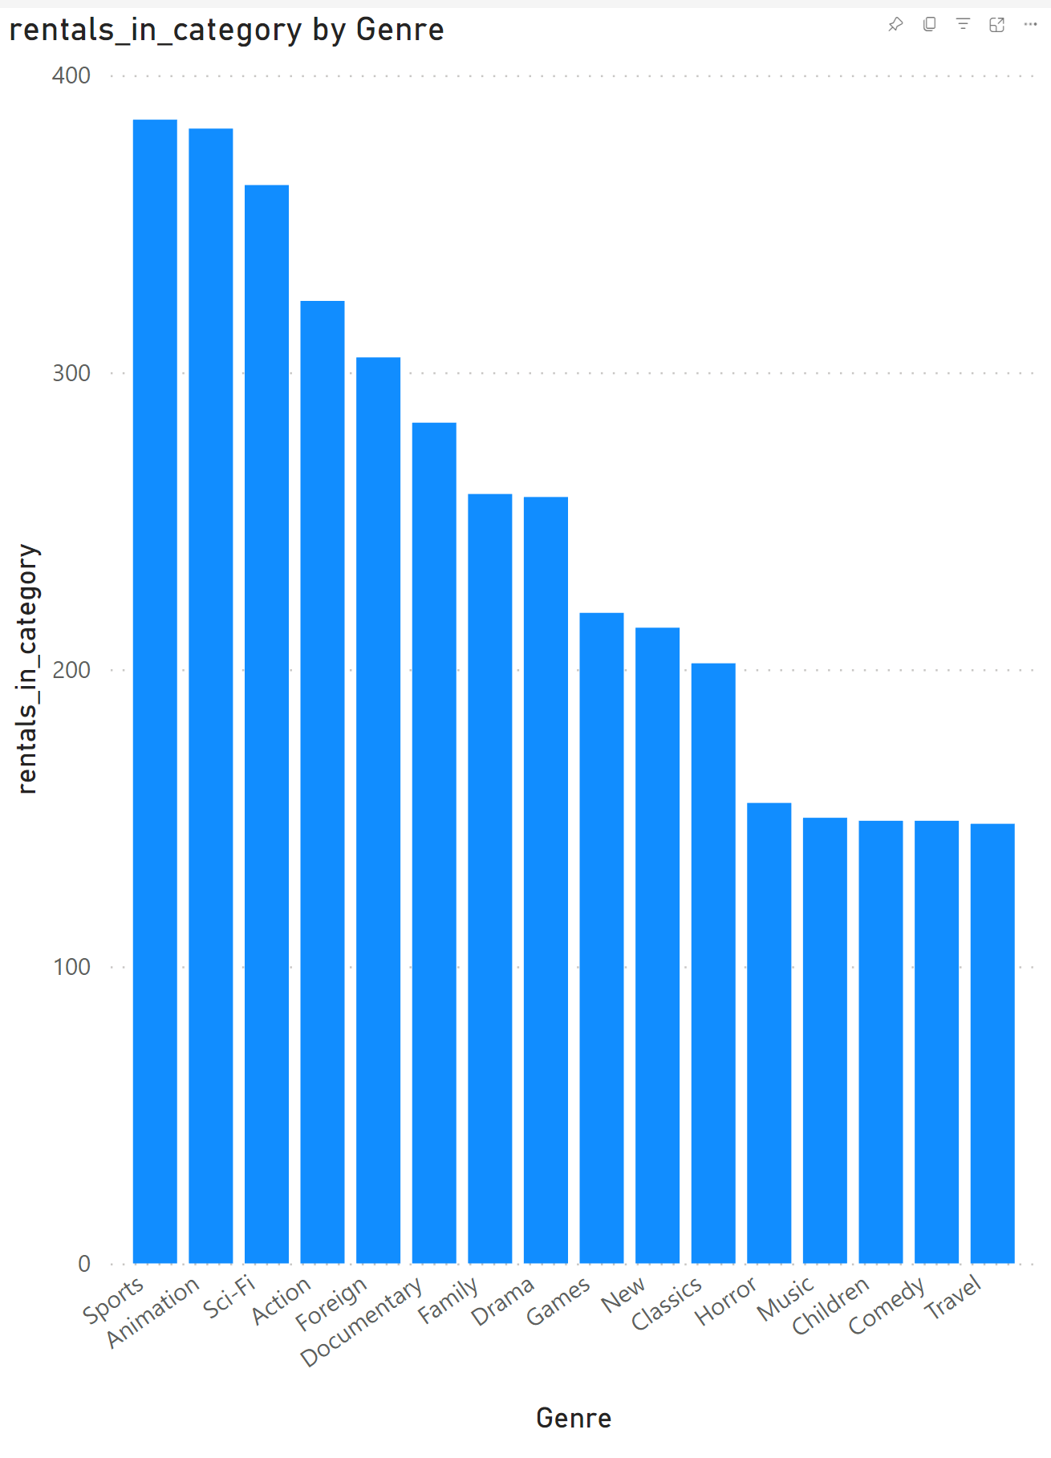
Rentals Per Genre
﻿At 385, Sports had the highest rentals_in_category and was 160.14% higher than Travel, which had the lowest rentals_in_category at 148.
﻿Across all 16 Genre, rentals_in_category ranged from 148 to 385.
Notes:
with t1 as (
SELECT concat(cu.first_name,' ',cu.last_name,cu.customer_id) customer, c.name category, count(f.*) cat_rentals
FROM category as c
JOIN film_category as fc
ON fc.category_id = c.category_id
JOIN film as f
ON f.film_id = fc.film_id
JOIN inventory as i
on i.film_id = f.film_id
JOIN rental as r
ON r.inventory_id = i.inventory_id
JOIN customer as cu
on cu.customer_id = r.customer_id
GROUP BY 1, c.name),
t2 as (SELECT customer, max(cat_rentals) most_pop_cat
FROM t1
GROUP BY 1)
SELECT t1.*, t2.most_pop_cat
FROM t1
JOIN t2 ON
t2.customer = t1.customer
WHERE cat_rentals = most_pop_cat

Slide 4
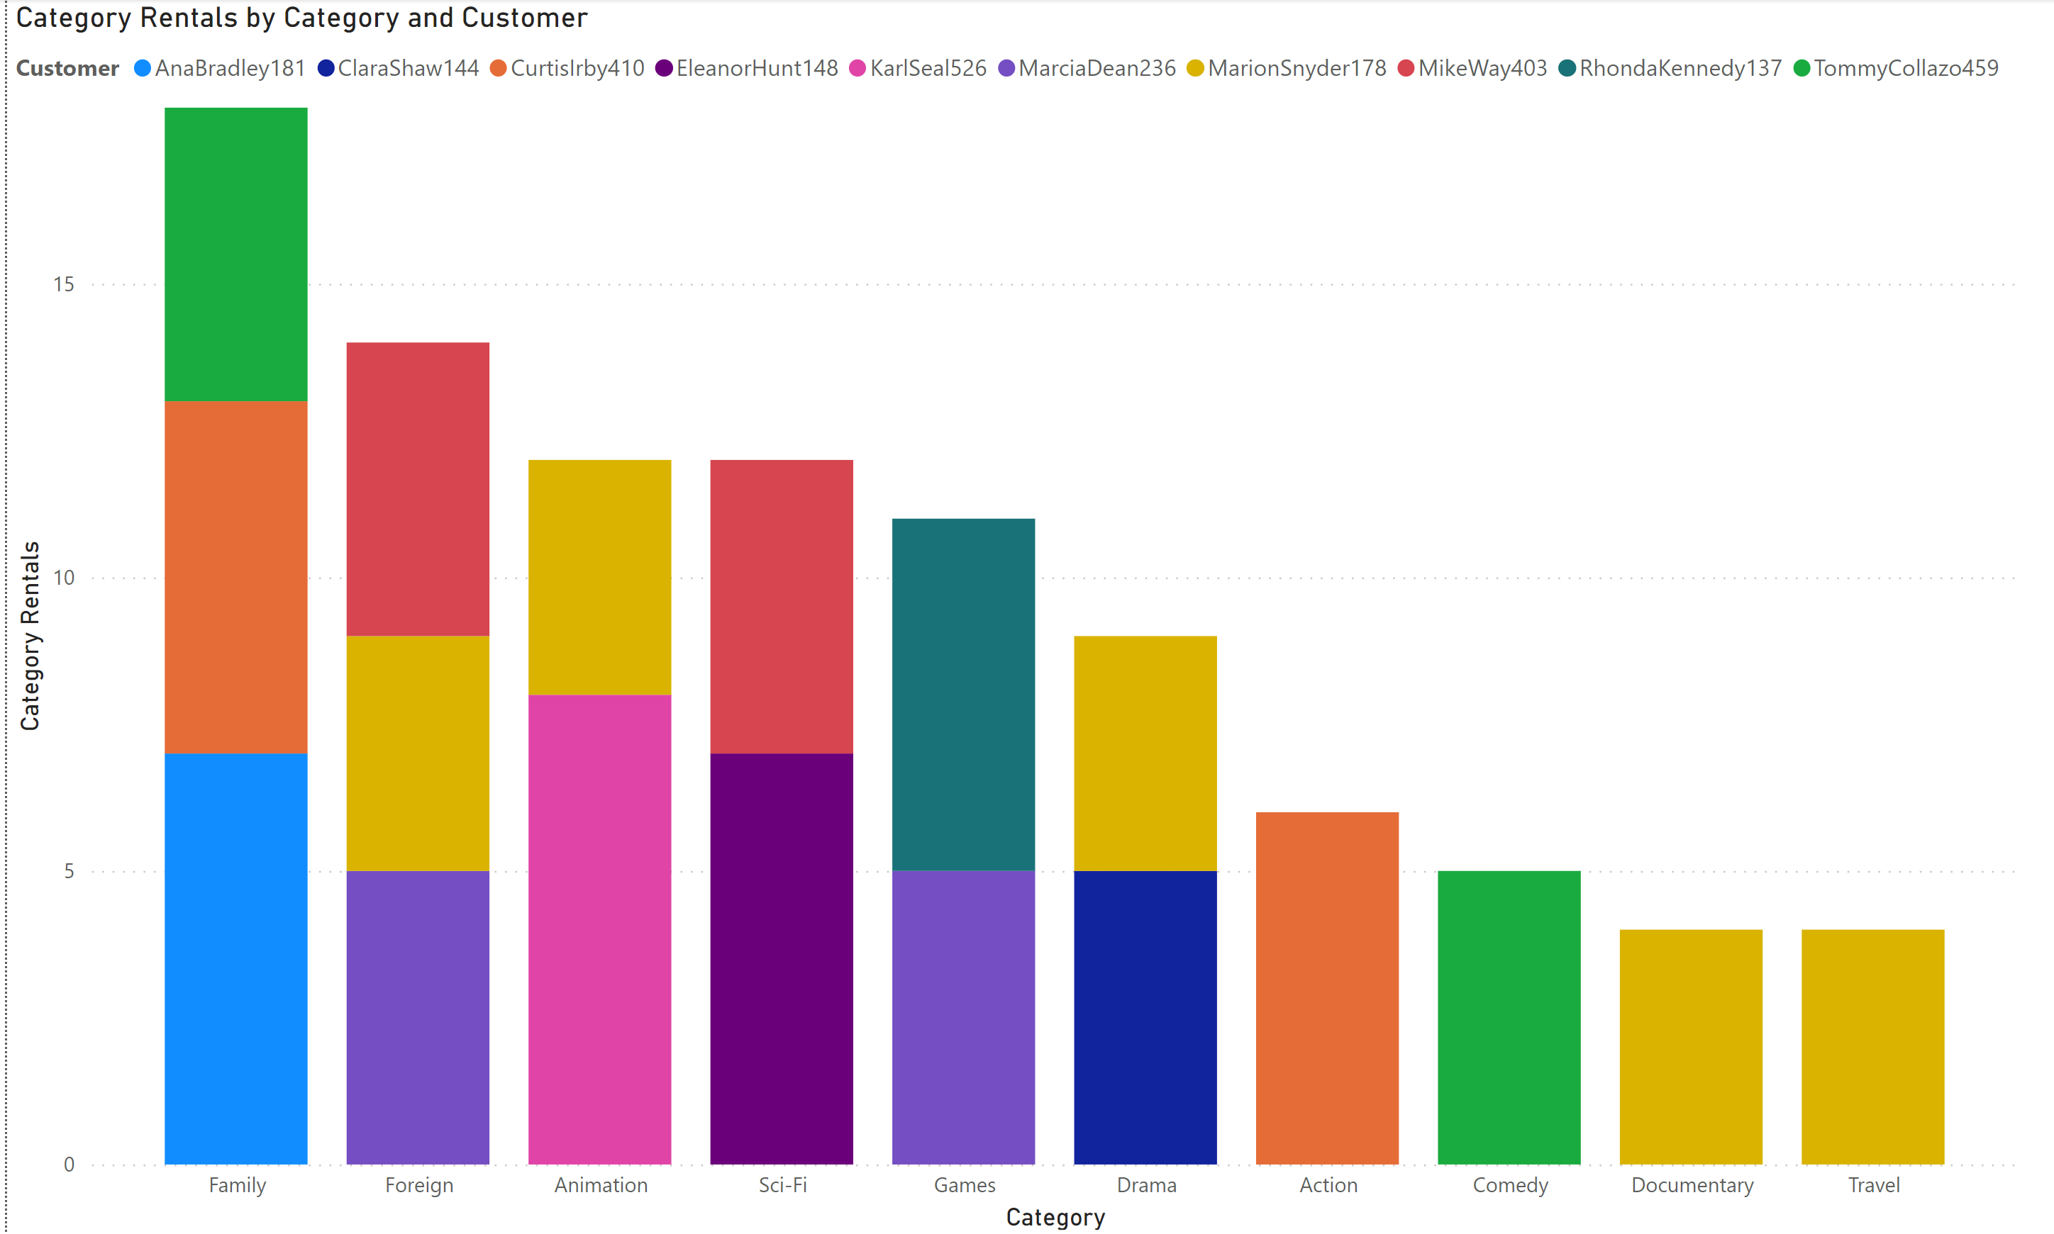
Top Categories for Top 10 Customers
<visualization>
Our most loyal customers enjoy a wide variety of movies but Family rentals are highest overall.
Notes:
with t1 as (
SELECT concat(cu.first_name,cu.last_name,cu.customer_id) customer, c.name category, count(f.*) cat_rentals
FROM category as c
JOIN film_category as fc
ON fc.category_id = c.category_id
JOIN film as f
ON f.film_id = fc.film_id
JOIN inventory as i
on i.film_id = f.film_id
JOIN rental as r
ON r.inventory_id = i.inventory_id
JOIN customer as cu
on cu.customer_id = r.customer_id
GROUP BY 1, c.name),
t2 as (SELECT customer, max(cat_rentals) most_pop_cat
FROM t1
GROUP BY 1),
t3 as (SELECT
concat(c.first_name,c.last_name,c.customer_id) customer,
sum(p.amount) amount,
RANK() OVER(ORDER BY sum(p.amount) DESC) as rank
FROM customer as c
JOIN payment as p
ON
p.customer_id = c.customer_id
GROUP BY 1),
t4 as (SELECT
customer, amount, rank
FROM t3
WHERE rank < 11)
SELECT t1.*
FROM t1
JOIN t2 ON
t2.customer = t1.customer
INNER JOIN t4
ON t4.customer = t1.customer
WHERE cat_rentals = most_pop_cat
ORDER BY t4.rank

Slide 5
PowerBI Dashboard
All visuals plus some extras can be found in my PowerBI workspace here

